Slide 1
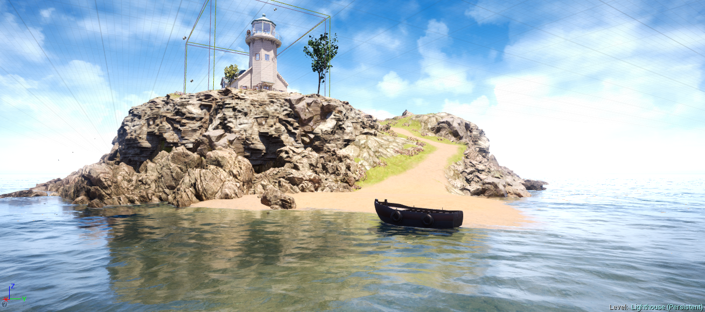
Dead Alive
Charandeep Singh
Meet Maisheri
Uttam Bogati
Guide- Prof. Jaya Gupta
A Multiplayer Shooting Game Using Unreal Engine

Slide 2
Abstract
The goal of this project is to prove the development of a videogame using Unreal Engine, based on an agile methodology that is viable in an economic, quick and sustainable way.
This methodology has four stages that are: preproduction, production, testing and postproduction that were advantageous to finish the project on time.
To achieve this, we have developed a thrilling multiplayer cooperative third-person shooter featuring massive swarms of artificially intelligent zombies that recklessly rush their living prey. Focused on fast-paced gameplay.
In conclusion, we achieve to prove the applicability of the four stages methodology since we made a high quality game in a short period of time, using limited resources.

Slide 3
Why are we using Unreal Engine?
Benefits of using a game engine like Unreal Engine are: reusable code with libraries, the concept of object oriented programming and process of computer generated graphics.
The engine has specialized libraries for game development. In addition, the use of object oriented programming, makes it possible to create class the traditional way, but in a very intuitive way such is the case with the Character class, this class contains all the necessary code to create a character on the game.

Slide 4
Problem Statement
To prove the development of a videogame using Unreal Engine, based on an agile methodology that is viable in an economic, quick and sustainable way.
This methodology has four stages that are: preproduction, production, testing and postproduction that were advantageous to finish the project on time.

Slide 5
Objectives
The objective of this project is to build a thrilling multiplayer cooperative third-person shooter featuring massive swarms of artificially intelligent zombies that recklessly rush their living prey.
To prove the applicability of the four stages methodology, which is preproduction, production, testing and postproduction.

Slide 6
Scope
The Scope of our game is limited to survive from Zombie Apocalypse on an Island.
We will be having a limited materials for our survival.
We can tackle the Zombie using weapons which we found on Island.
The motive of the game is to survive as well as save the Lighthouse from Zombies capturing it.

Slide 7





Technology Stack

Slide 8
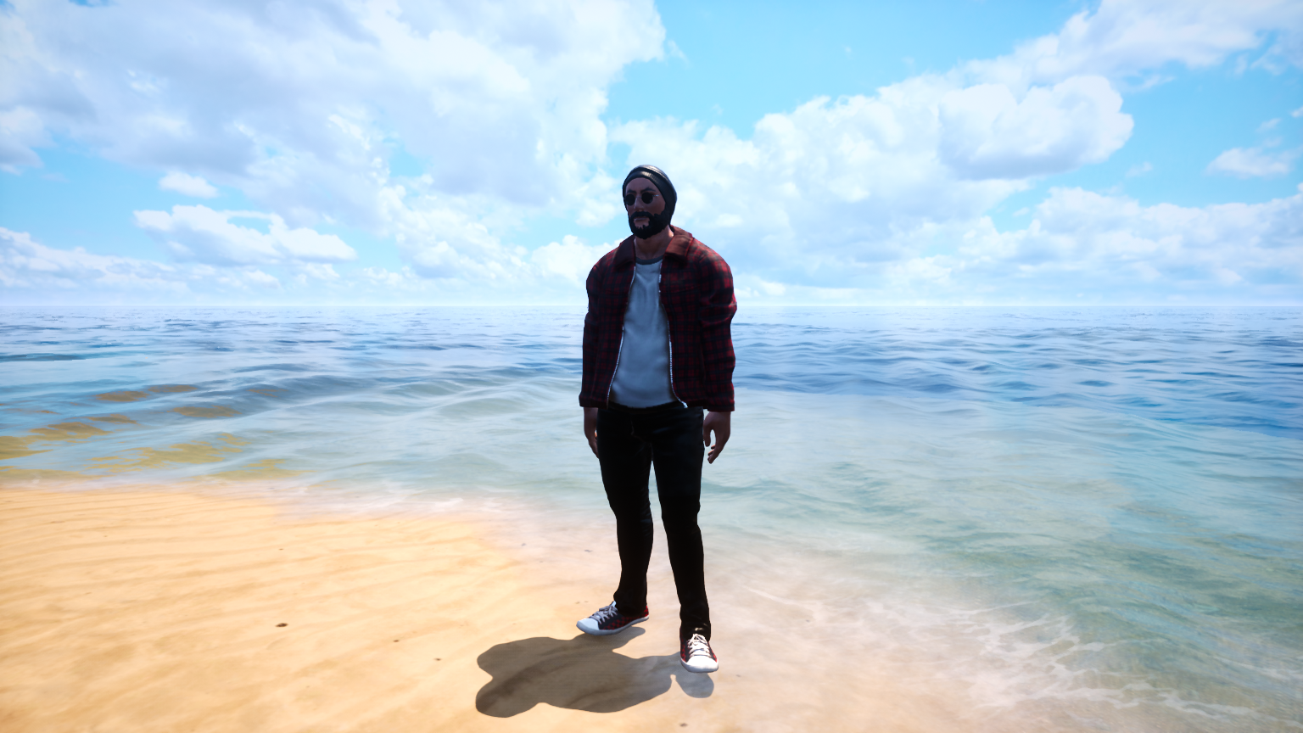
In-game Snaps

Slide 9
In-game Snaps

Slide 10
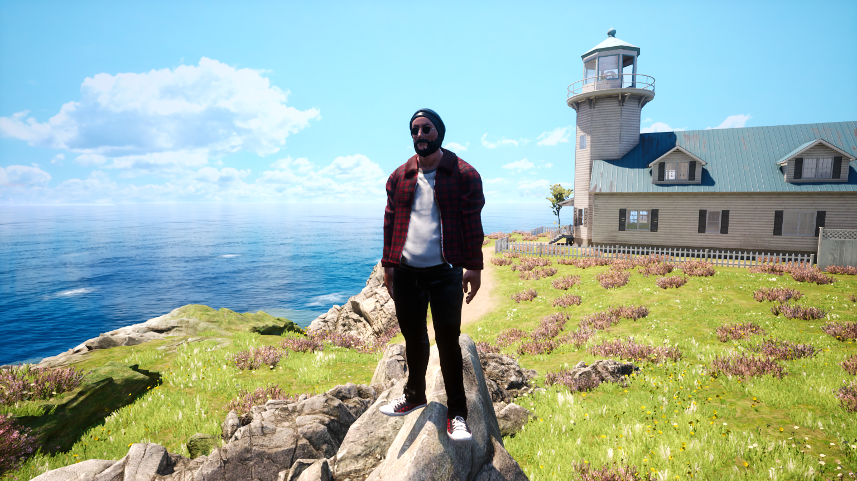
In-game Snaps

Slide 11
References
F. Zhu (2016, 1) Industry Outlook [Online]. Available: http://fzdschool.com/entertainment -design/industry-out look
EPIC (2016, 1) Unreal Engine Features [Online] Available: https://www.unrealengine.com/unreal-engine-4
R. Kuskuntla, E. Imsand y J.A. “Drew” Hamilton, “Enhanced Expert Field Medical Training Simulations and their effect on the Modern Combat Life Saver Training Procedures”, Auburn University, AL – 36849, 2006, pp 4-5.
C. Rubino “Level design optimization guidelines for game artists using the Epic Games: Unreal Engine 2”, RMIT University, 2006, pp 27-30
G. Hodkinson “Taking animation project learning into the virtual environment” Massey University, 2015, pp 1-2
J. Wilson (2015, 1) Tutorial: Physical Based Rendering, And You Can Too! [Online]. Available: http://www.marmoset.co/toolbag/learn/pbrpractice

